Slide 1
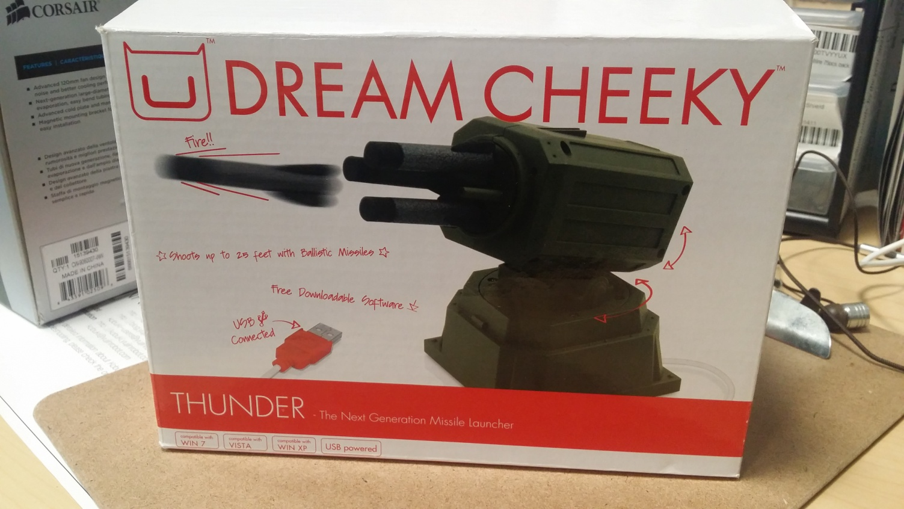
DreamCheeky Thunder Conversion Guide
Stephan Chauvin

Slide 2
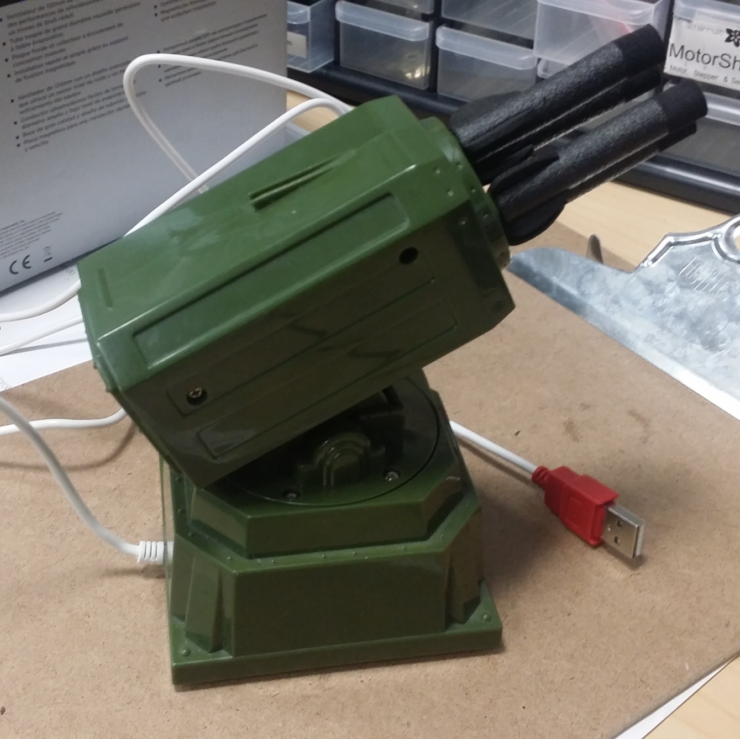
The Turret
The turret of the DreamCheeky Thunder desktop missile launcher features a pan-tilt gimbal mount with slip gears, allowing for both autonomous and manual adjustment. This is what we want, so we’re going to replace it with our own equipment.

Slide 3
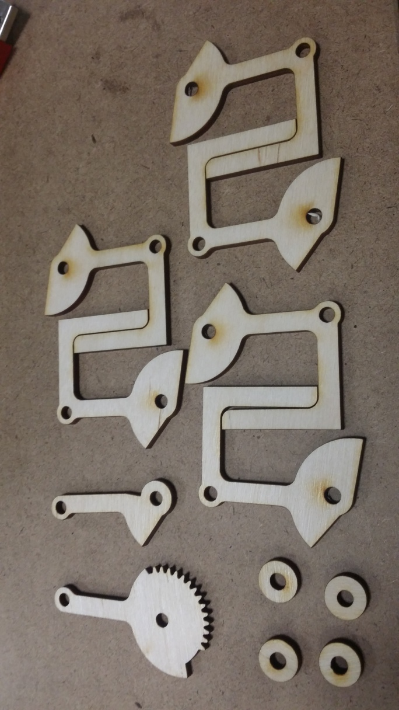
Mount Materials
The CAD file ‘submounts v3’ should provide most of the necessary parts to build the mount:
‘Submount’
‘Leg’
‘Gear’
‘Ring’
There are a few extras included, just in case.
You will also need two 8/32” pan-head machine screws:
1x 2”
1x 1 ¼”
NOTE: The CAD file assumes a 3.2 mm stock (shown here in wood). Make sure!

Slide 4
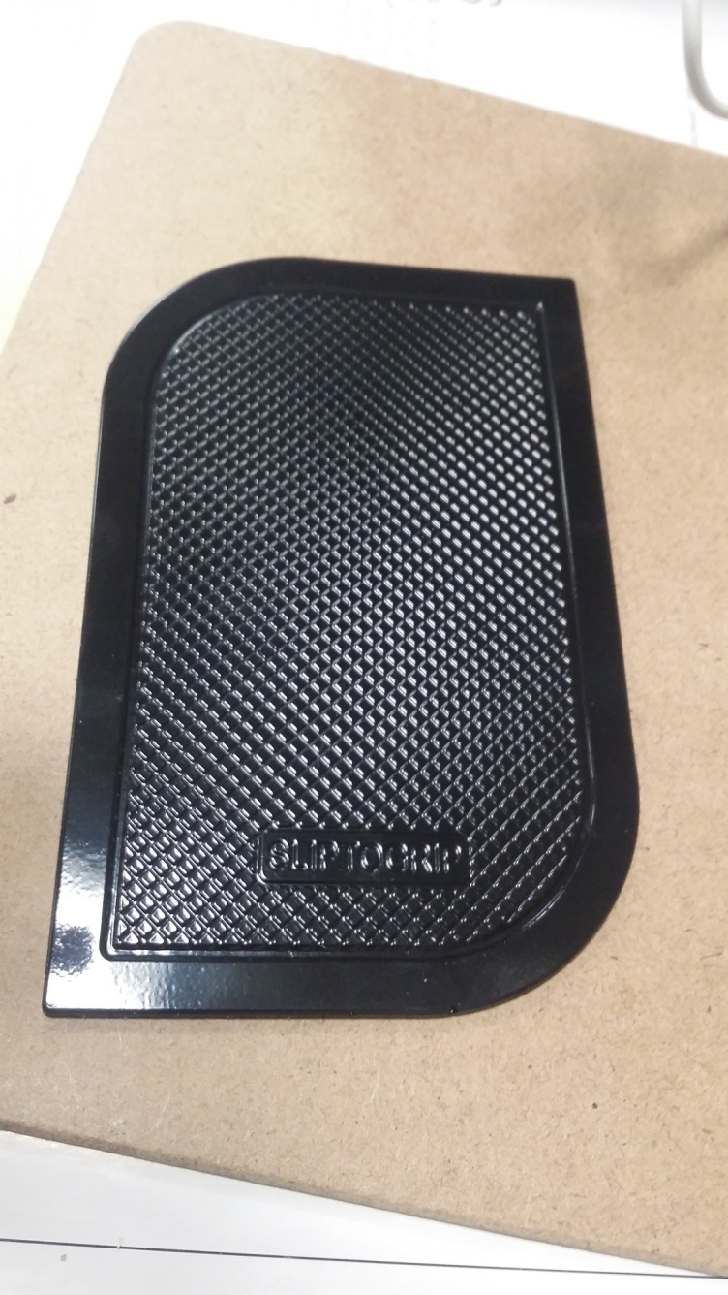
Nano-Pad
We add a nano-pad to the new mount to ensure that the phone won’t fall off during use. Most commercially available pads in the 3”x5” range will work.
The pad MUST be thin! If it’s too thick, the induction field will be weak and your phone will charge too slowly to offset the power comsumption from use.

Slide 5
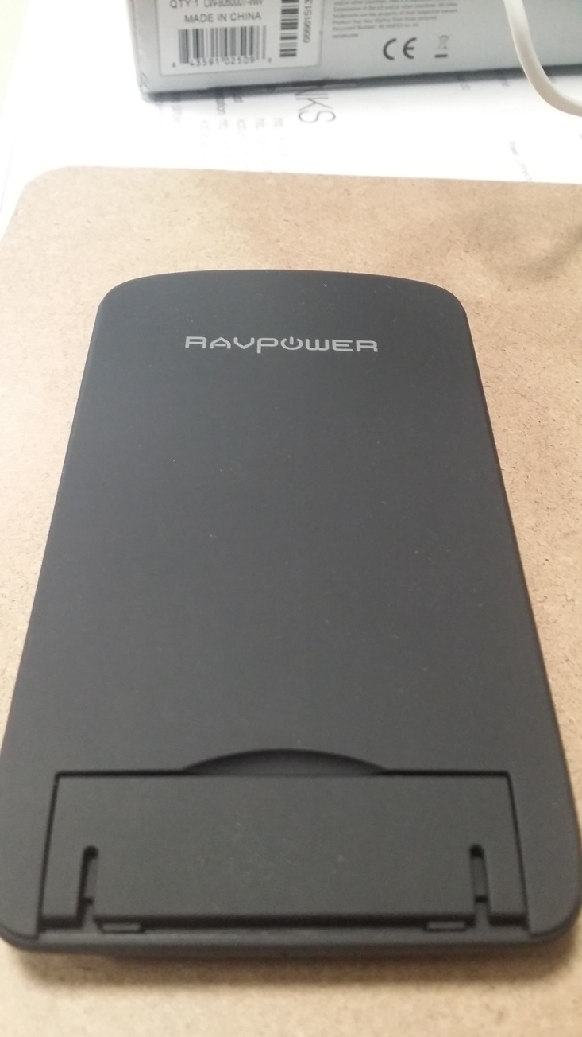
The Charger
We use a 3-coil Qi-enabled induction charging stand, with a deployable clip on the bottom.
The large size allows a large gripping surface for the nano-pad we’ll be gluing to it, and the 3 coils gives a strong induction field, allowing charging through the nano-pad, as well as most phone cases.

Slide 6
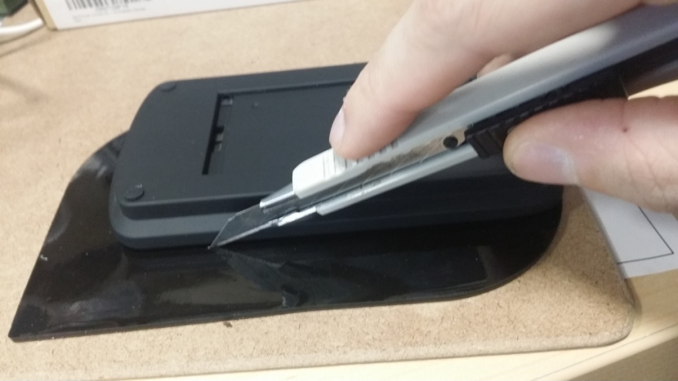
Parts Preparation 1
First, remove the charging pad’s rear ‘leg’; we won’t need it.
Next, using it as a template, trim the nano-pad to fit the charging pad.

Slide 7
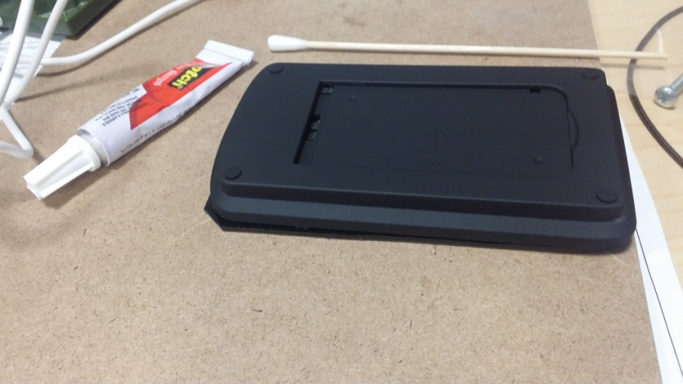
Parts Preparation 2
Glue the nano-pad and charging pad together.
Make sure to use a glue that works on the nano-pad’s silicone.
If the charging pad includes a small fold-out platform for the phone, don’t apply glue to it; it can be used in place of the nano-pad if the phone won’t stick.
Epoxy glue dissolves the plastic, but generally the pads will stick hard on their own. Tacky glue is probably the best choice to assist them in sticking more than the phone.

Slide 8
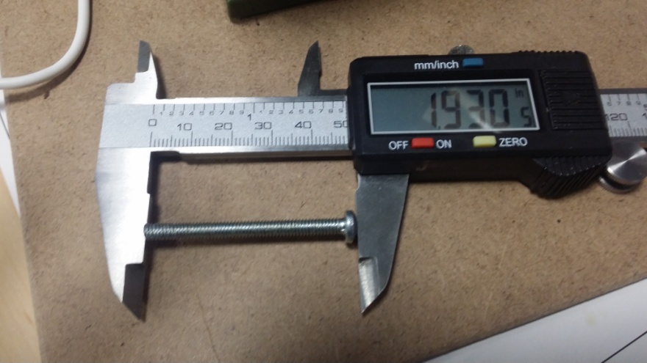
Parts Preparation 3
Cut/file down the 50mm bolt so that including the head, it measures just under 1.93” in length.
The bolt will form part of the new mount’s tilt axle, so this is important!
It may need to be filed down more for proper fitting later on.

Slide 9
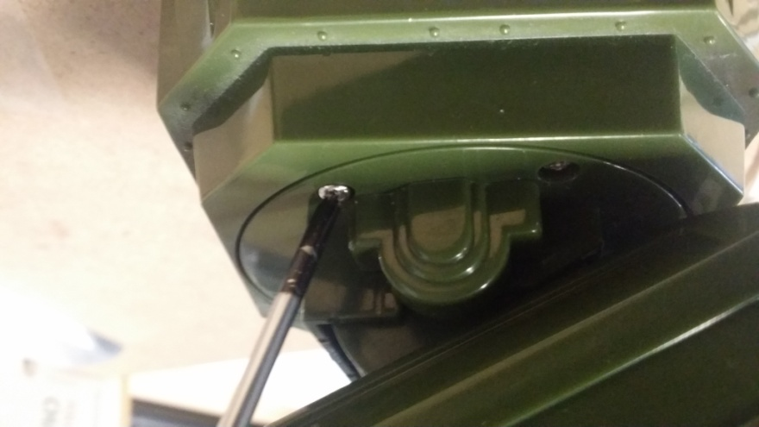
Disassembly 1
Unscrew the 4 screws holding the turret’s tilt axle to the turret deck.
You will need these later, so keep track of them!

Slide 10
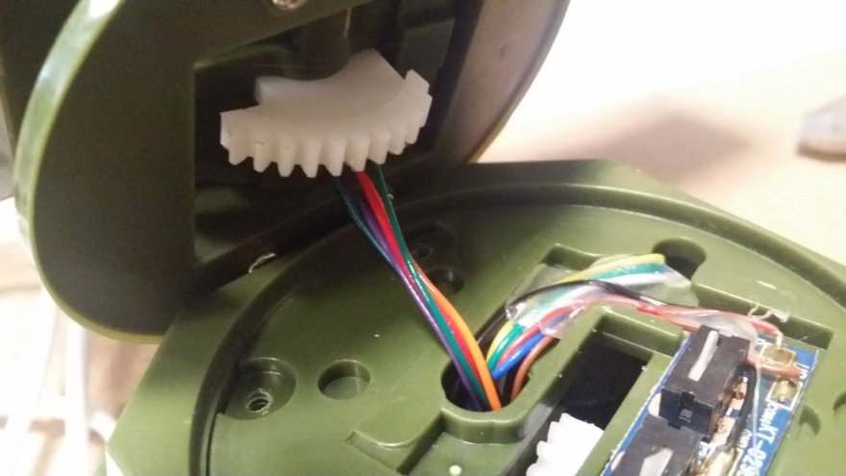
Disassembly 2
Once you have the turret off, take note of the wires leading from the base to the turret.
The purple and black wires power the LED indicator; we want to keep these.
The other 4 wires (red, orange, and two teal/light green) feed motors and sensors in the turret; we don’t need them, so we’ll cut them later.

Slide 11
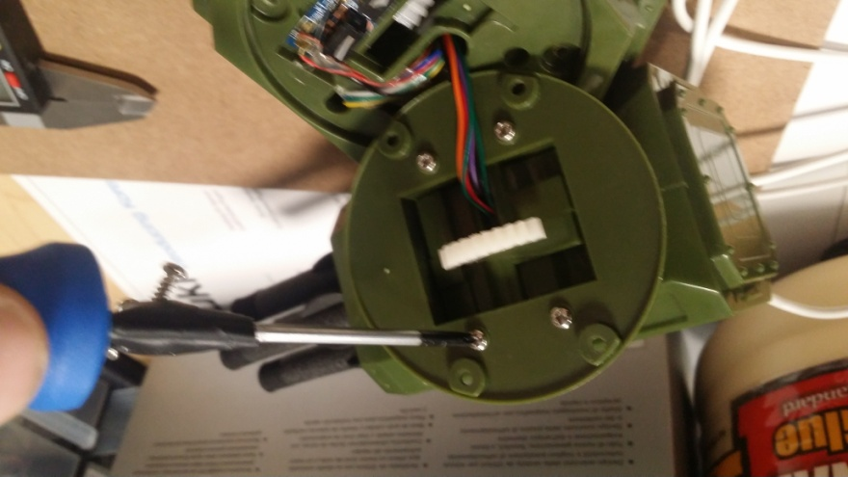
Disassembly 3
Next, unscrew half the bolts holding the axle heads in place.
You will need these later, so keep track of them.

Slide 12
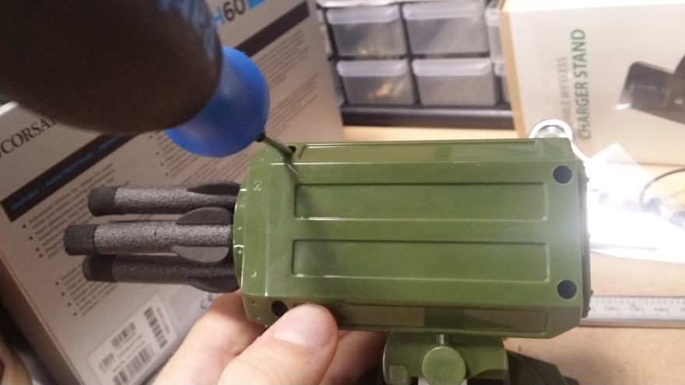
Disassembly 4
Now we have to open the turret itself.
Remove the 4 screws on the turret’s left side.
We don’t need these later but they’re handy to keep the turret intact.

Slide 13
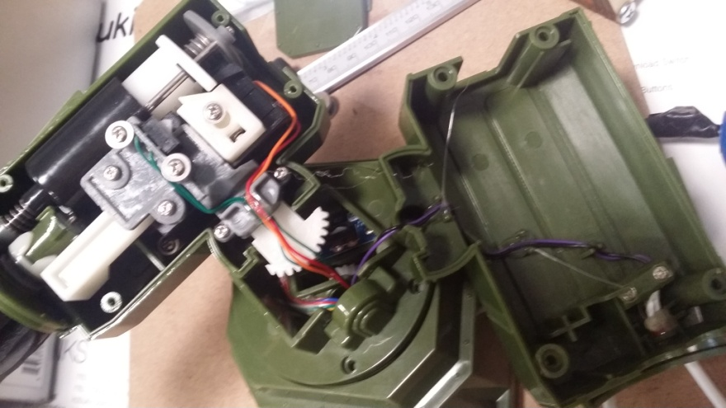
Disassembly 5
Here is shown the interior of the turret.
Don’t worry about the bits on the left; we won’t be using them.
To recover the LED indicator (on the right), begin by removing the glue holding the wires in place. It should pop off with a small tug.

Slide 14
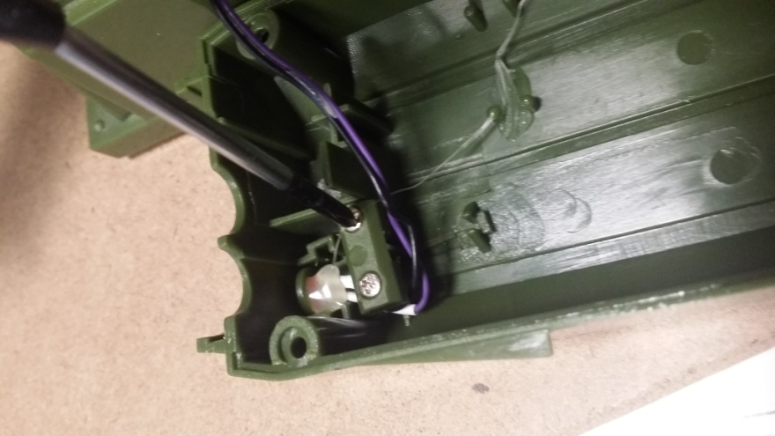
Disassembly 6
Two screws hold the LED indicator itself in place; remove them.
On some turrets there is also an additional blob of epoxy on the LED itself. CAREFULLY remove this.

Slide 15
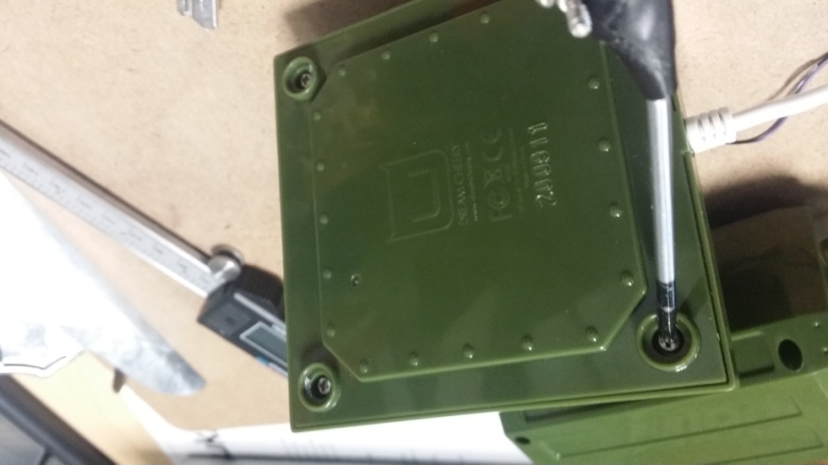
Disassembly 7
Now we begin to cut the unnecessary wires.
Start by removing the bottom panel. The screws are underneath the anti-friction pads at the corners.

Slide 16
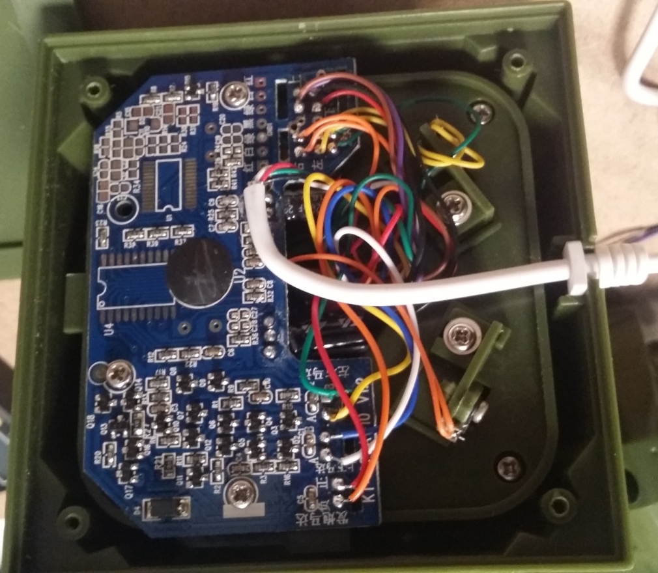
Wires
CAUTION! Cutting the wrong wire will ruin the turret. Be ABSOLUTELY sure you’re cutting the right ones!
You may confirm the correct wire by pulling on it while looking at the wires leading from the turret to the base.

Slide 17
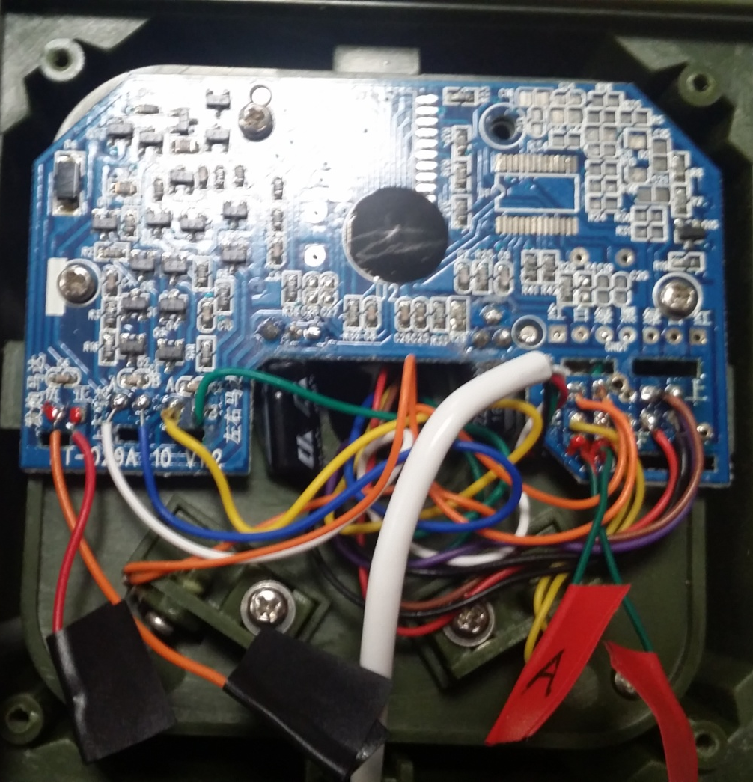
Wires 2
These should be the correct wires (marked by red at the connection point and the circles).
CHECK YOUR WIRES BEFORE CUTTING.
Once the wires are cut and the ends wrapped to prevent shorts, replace the bottom cover.

Slide 18
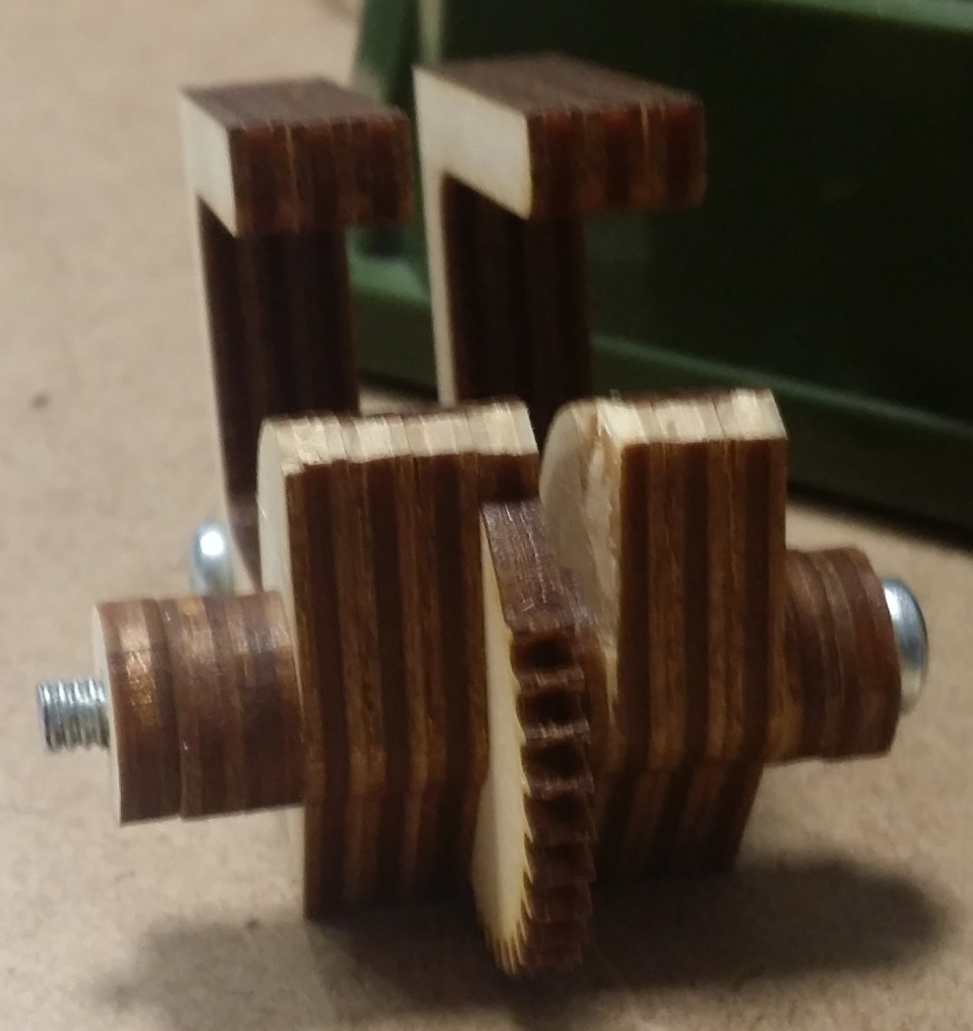
The Sandwich
Our new mount is made of the following parts:
Modified machine screw
5x ‘ring’ parts
6x ‘submount’ parts
1x ‘gear’ part
1x ‘leg’ part
The order of the parts, from the head of the screw, is as follows:
2 rings
3 submounts
The leg
The gear
3 more submounts
3 rings
The mount may be held together (mostly) with the smaller bolt. Do not affix a nut to the longer bolt; this will interfere with the turret.
You may need to trim the forward-facing corner of the sandwich to ensure smooth operation (shown here).
Note - The wooden bits of the 'sandwich' are NOT glued together. The machine screws provide enough restriction on their own, and the one time I tried gluing it the result ended up being too rigid and caused the gears to skip

Slide 19
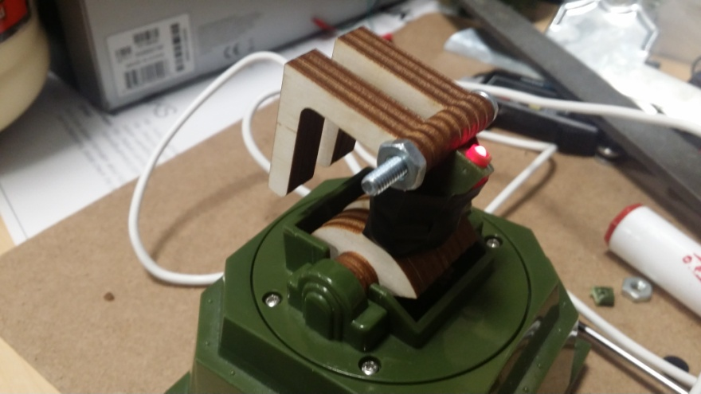
Mounting 1
Fit the sandwich into the tilt axle, facing as shown.
Be sure that the sandwich faces AWAY from the wire port on the base; if they’re facing the same direction, the mount is in backwards!
If you are using the LED indicator, feed the wires through the sandwich before securing it in place. Tape or glue it where it’s convenient.
Replace the screws on the axle head, then replace the screws on the turret deck.

Slide 20
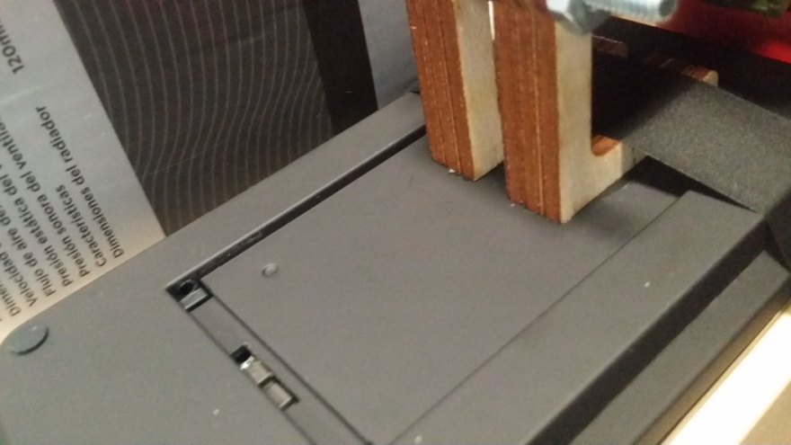
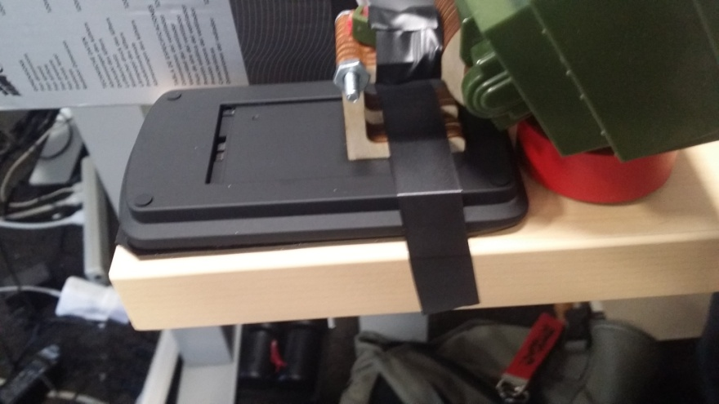
Mounting 2
Finally, glue the charging pad to the sandwich as shown.
Wood glue seems to work if adequately clamped.
Be sure to support the base during the curing process; failure to do so will weaken the glue.

Slide 21
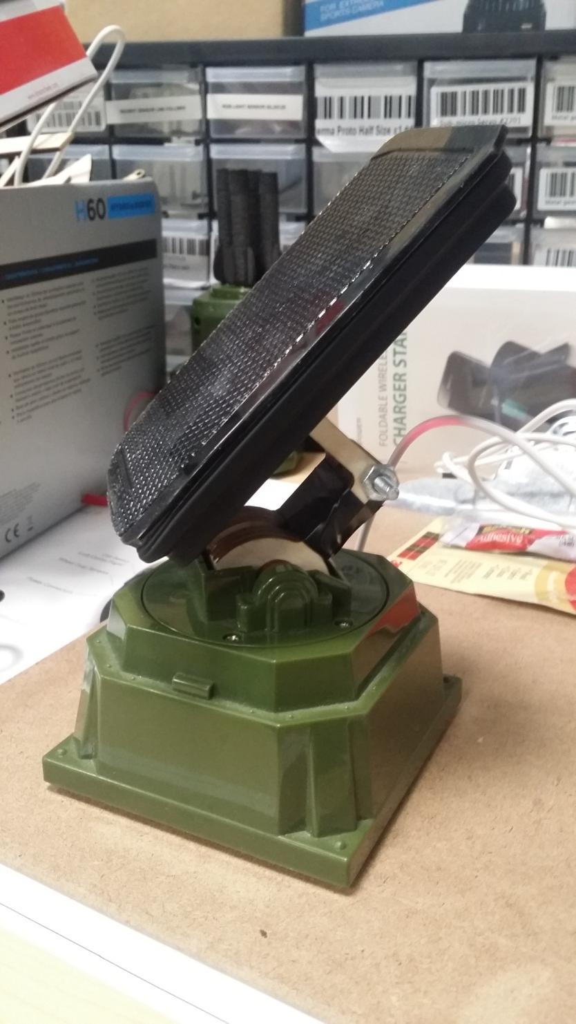
Finished!

